Slide 1
Introduction to React Element

Slide 2
Elements are the smallest building blocks of React apps. An element specifies what should be there in our UI. An Element is a plain object describing what we want to appear in terms of the DOM nodes.
Creating a React Element is Cheap compared to DOM elements. An Element can be Created by using JSX or React without JSX. Lets create our first React Element using JSX.

Slide 3
Open index.js file from src folder.
const element = <h1>Hello, world</h1>;
created an Object of type h1 and assigned it to a variable called as element. This element should be rendered into the Browser DOM, and for that we need a container.
Open Index.html and there is a div with id as root and we will use that div as our container.
The above created Element can be rendered into it By writing
ReactDOM.render(element, document.getElementById('root'));
Lets say we want to assign some styles to this element.
Create a css class with classname as testclass in index.css. Apply this class to the element using className attribute.
Const element=<h1 className="testClass">Hi...</h1>
An Element contains type and properties, here h1 is the type and this element contains className as property. An Element can be as simple as the one we have created or an element can contain elements inside it.

Slide 4
const element = (
<div>
<h1>Welcome to React Programming World</h1>
<h2>Understanding React Rendering…</h2>
</div> );
ReactDOM.render(element, document.getElementById('root'));
save these changes and observe the response in the browser.

Slide 5
A React Element can also be created by using
const element = React.createElement("h1",null,'Hello World');
CreateElement method takes few parameters. First one is the type of Element we want to create like h1 or h2 or div. Second parameter specifies the Properties we want to apply to this element. Third one represents the Child Element or Elements that has be placed inside the Parent one. The above line of code tells React that we want a h1 element without properties or attributes applied and Hello World being the Child in it.
If we want to apply the css class we have created to this element then, lets add a Property called className
const element = React.createElement("div",{className:"testClass"},'Hello World');

Slide 6
Now lets say, we want to create one h1 tag and one h2 tag inside the div element. To achieve this, we have to pass two elements as child elements to this div. So lets go ahead and make changes.
const element=React.createElement("div",{className:"testClass"},
React.createElement("h1",null,'Welcome to Pragim Technologies'),
React.createElement('h2',null,'I am from h2 Tag'));
save this change and see the output in the browser.

Slide 7
factory
Instead of creating many if statements we create a function that will dynamically create our components based on the payload. This function is called the factory function. And our App now looks like this. In brief, using a factory function to dynamically create components is factory pattern.

Slide 8
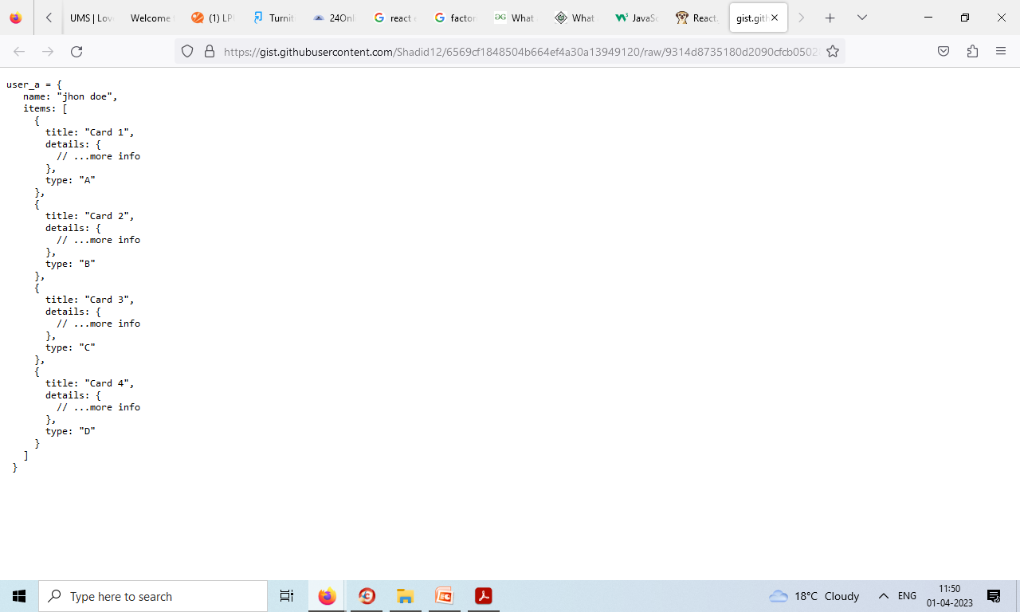
Imagine we are building a dashboard. When our user logs in we get a user object back from our back-end. Based on that object we will determine what our user sees in the dashboard. Let’s say user_a is an object that is returned from our server

Slide 9
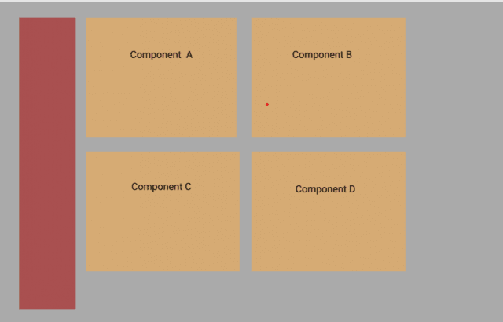
Based on the type of object we will render a card component. Let’s imagine that this is what our users would see:
Now that looks pretty straight forward. We have 4 types of card components so we can write our components as follows and render them in our
App component (Container Component) with a simple switch statement.

Slide 10
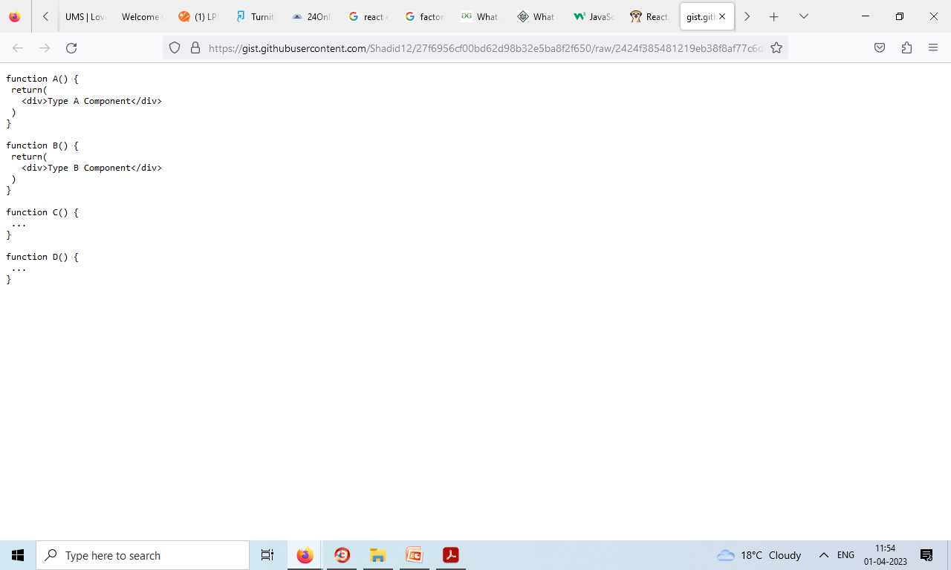

Slide 11
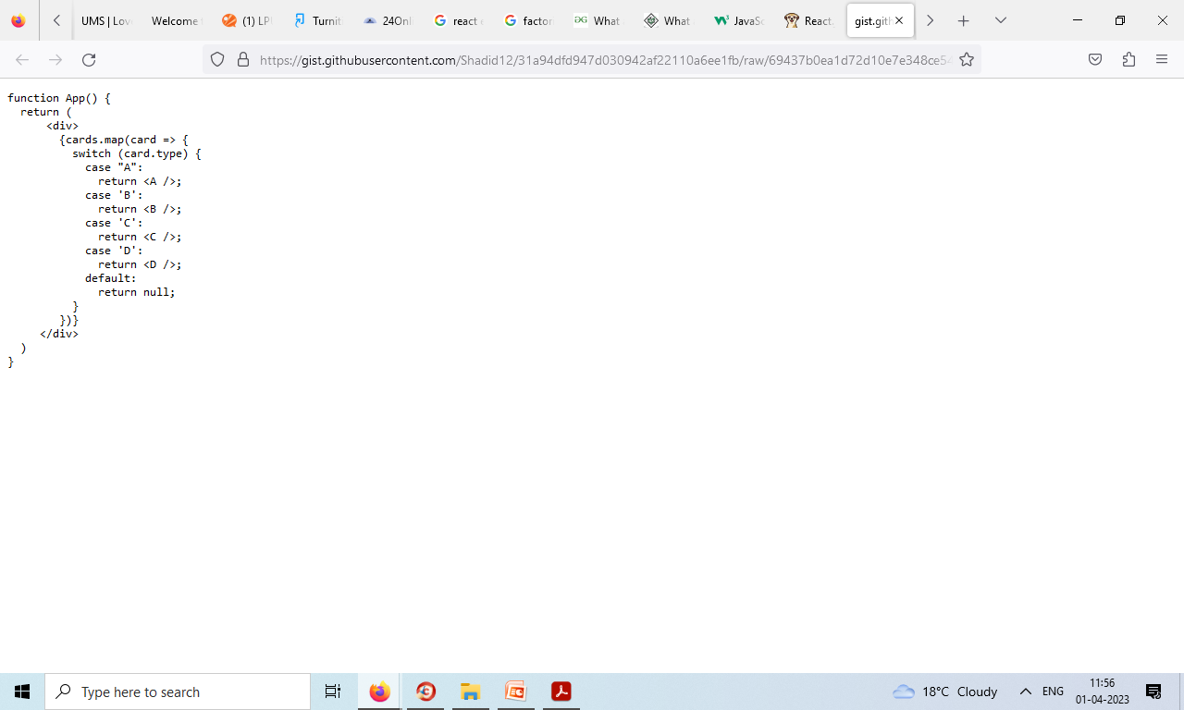
App.jsx

Slide 12
However, over time as our application becomes popular we were told to add 10 more different types of card components. So now we have cards A,B,C,D,E,F,G,H,I,J,K … and so on. Now of course we can choose to keep adding if statements or a switch statement. However, soon it will start to look messy.
Also we will be violating the Single Responsibility Principle. App component should not be concerned with what to render based on payload. We need a layer of abstraction to keep our code clean.
Alright, so here’s the solution. Instead of creating many if statements we create a function that will dynamically create our components based on the payload. This function is called the factory function.

Slide 13
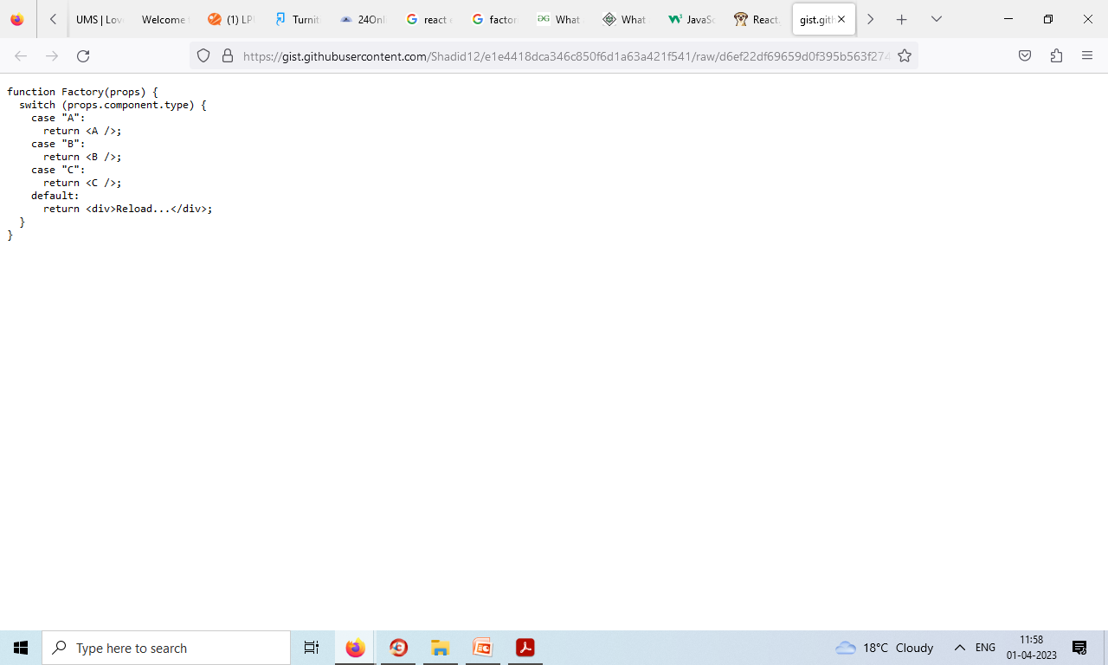
factory function

Slide 14
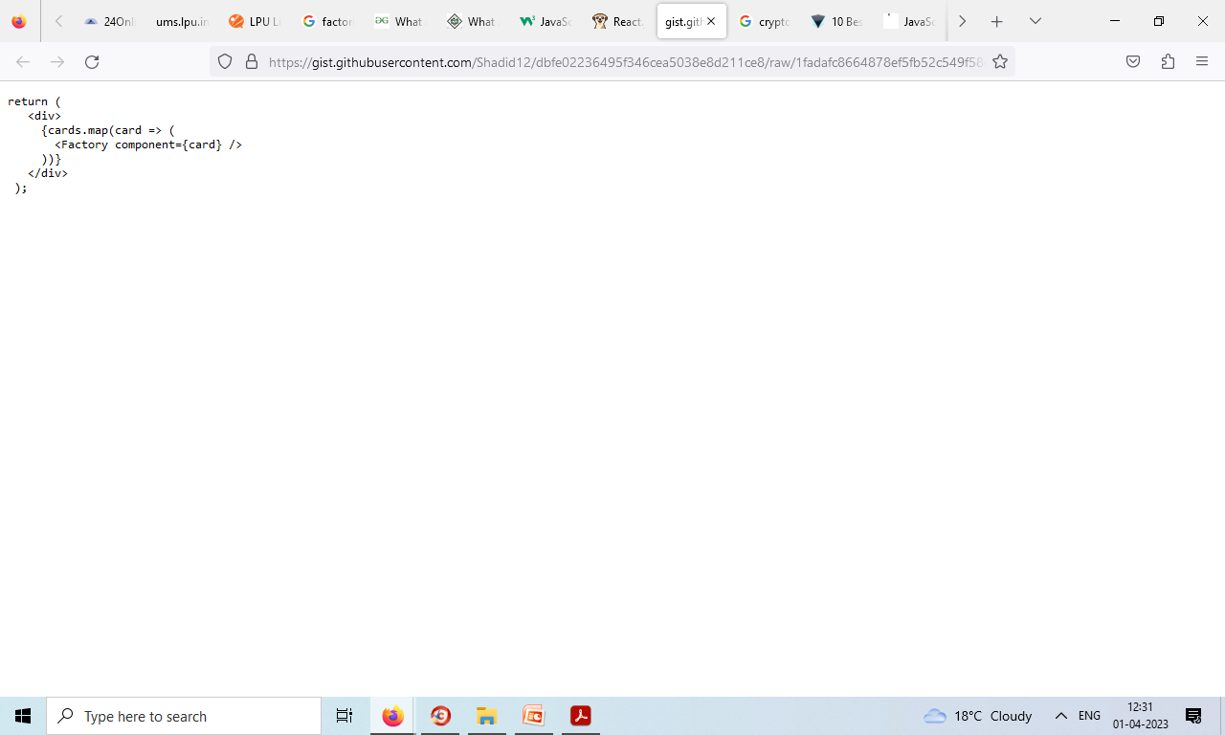
App now looks like this.
using a factory function to dynamically create components is factory pattern.

Slide 15
jsx
JSX stands for JavaScript XML. JSX allows us to write HTML in React.

Slide 16
What is JSX?
JSX stands for JavaScript XML.
JSX allows us to write HTML in React.
JSX makes it easier to write and add HTML in React.

Slide 17
Coding JSX
JSX allows us to write HTML elements in JavaScript and place them in the DOM without any createElement() and/or appendChild() methods.
JSX converts HTML tags into react elements.
You are not required to use JSX, but JSX makes it easier to write React applications.

Slide 18
Code with and without JSX
const myElement =
<h1>Here the use of JSX!</h1>;
const root = ReactDOM.createRoot(document.getElementById('root'));
root.render(myElement);
const myElement = React.createElement('h1', {}, ‘Not used JSX!');
const root = ReactDOM.createRoot(document.getElementById('root'));
root.render(myElement);
As you can see in the first example, JSX allows us to write HTML directly within the JavaScript code.
JSX is an extension of the JavaScript language based on ES6, and is translated into regular JavaScript at runtime.

Slide 19
Expressions in JSX
With JSX you can write expressions inside curly braces { }.
The expression can be a React variable, or property, or any other valid JavaScript expression. JSX will execute the expression and return the result:
Execute the expression 5 + 5:
const myElement =
<h1>React is {5 + 5} times better with JSX</h1>;

Slide 20
Inserting a Large Block of HTML
To write HTML on multiple lines, put the HTML inside parentheses:
const myElement = ( <ul> <li>Apples</li> <li>Bananas</li> <li>Cherries</li> </ul> );

Slide 21
Write if statements outside of the JSX code:
const x = 5;
let text = "Goodbye";
if (x < 10)
{ text = "Hello"; }
const myElement = <h1>{text}</h1>;
Write "Hello" if x is less than 10, otherwise "Goodbye":

Slide 22
import React from 'react';
import ReactDOM from 'react-dom/client';
const x = 5;
let text = "Goodbye";
if (x < 10)
{ text = "Hello";
}
const myElement = <h1>{text}</h1>;
const root = ReactDOM.createRoot(document.getElementById('root'));
root.render(myElement);

Slide 23
BabelJS
BabelJS is a JavaScript transpiler which transpiles new features into old standard. With this, the features can be run on both old and new browsers, hassle-free. An Australian developer, Sebastian McKenzie started BabelJS.

Slide 24
BabelJS manages the following two parts −
transpiling
polyfilling

Slide 25
What is Babel-Transpiler?
Babel-transpiler converts the syntax of modern JavaScript into a form, which can be easily understood by older browsers. For example, arrow function, const, let classes will be converted to function, var, etc. Here the syntax, i.e., the arrow function is converted to a normal function keeping the functionality same in both the cases.

Slide 26
What is Babel-polyfill?
There are new features added in JavaScript like promises, maps and includes. The features can be used on array; the same, when used and transpiled using babel will not get converted. In case the new feature is a method or object, we need to use Babel-polyfill along with transpiling to make it work on older browsers.

Slide 27
Here is the list of ECMA Script features available in JavaScript, which can be transpiled and polyfilled −
Classes
Decorators
Const
Modules
Destructing
Default parameters
Computed property names
Object rest/spread
Async functions
Arrow functions
Rest parameters
Spread
Template Literals

Slide 28
Features of BabelJS
Babel-Presets
Babel presets are a set of plugins, i.e., config details to the babel-transpiler that instruct Babel to transpile in a specific mode. We need to use presets, which has the environment in which we want the code to be converted. For example, es2015 preset will convert the code to es5.
Babel-Plugins
Plugins and Presets are config details for Babel to transpile the code. Babel supports a number of plugins, which can be used individually, if we know the environment in which the code will execute.

Slide 29
Babel-Polyfills
There are some features like methods and objects, which cannot be transpiled. At such instances, we can make use of babel-polyfill to facilitate the use of features in any browser. Let us consider the example of promises; for the feature to work in older browsers, we need to use polyfills.
Babel-cli comes with a bunch of commands where the code can be easily compiled on the command line. It also has features like plugins and presets to be used along with the command making it easy to transpile the code at one go.

Slide 30
Advantages of using BabelJS
BabelJS provides backward compatibility to all the newly added features to JavaScript and can be used in any browsers.
BabelJS has the ability to transpile to take the next upcoming version of JavaScript - ES6, ES7, ESNext, etc.
BabelJS can be used along with gulp, webpack, flow, react, typescript, etc. making it very powerful and can be used with big project making developer’s life easy.
BabelJS also works along with react JSX syntax and can be compiled in JSX form.
BabelJS has support for plugins, polyfills, babel-cli that makes it easy to work with big projects.

Slide 31
Disadvantages of using BabelJS
BabelJS code changes the syntax while transpiling which makes the code difficult to understand when released on production.
The code transpiled is more in size when compared to the original code.
Not all ES6/7/8 or the upcoming new features can be transpiled and we have to use polyfill so that it works on older browsers.

Slide 32
BabelJS - Environment Setup
NodeJS
Npm
Babel-CLI
Babel-Preset
IDE for writing code

Slide 33
NodeJS
To check if nodejs is installed on your system, type node –v in the terminal. This will help you see the version of nodejs currently installed on your system.
BabelJS - CLI
npm install --save-dev babel-cli
babel-preset
Execute the following command to install babel-preset −
npm install --save-dev babel-preset-env

Slide 34
babel-core
Execute the following command to install babel-core −
npm install --save-dev babel-core

Slide 35
Introduction to Webpack Module Bundler
Webpack: Webpack is a static module bundler used for JavaScript applications. Since webpack understands only JavaScript and JSON files, It transforms front-end assets such as HTML, CSS, and images into valid modules if the corresponding loaders are included. While Processing your application webpack internally builds a dependency graph that maps every module your project needs and produces one or more output bundles.

Slide 36
Some core concepts of webpack are:
Entry
Output
Loaders
Plugins
Mode

Slide 37
Entry
An entry point defines which module webpack should use to start building out its internal dependency graph. The entry point’s default value is ./src/index.js, but in the webpack configuration., you can specify a different or multiple entry points by setting an entry property within this file.
webpack.config.js
module.exports = {
entry: './GeeksForGeeks/file.js‘
};

Slide 38
Output
The output property indicates webpack where to emit the bundles it creates and tells the way to name these files. By default, its value is ./dist/main.js for the main output file and it is ./dist folder for any other generated file, but we can change this part of the process by specifying an output field in our configuration.
Filename: webpack.config.js
const path = require('path');
module.exports = {
entry: './GeeksForGeeks/file.js',
output: { path: path.resolve(__dirname, 'gfg'),
filename: 'GeeksForGeeks-webpack.bundle.js‘
}
};

Slide 39
Loaders
Since webpack only understands JavaScript and JSON files. Loaders process other types of files and after that, it converts them into the valid modules which can be consumed by our application, and add them to the dependency graph.
Loaders preprocess the other type of files and them to the bundle, Loaders have two properties in webpack configuration through which they achieve this:
The test property
The use property
The test property: It is used to identify which file or files should be transformed by the respective loader. Usually, a regular expression is used to identify the file or files which should be transformed.
The use property: It is used to indicate which loader should be used to do the transforming.

Slide 40
Filename: webpack.config.js
const path = require('path');
module.exports = {
output: {
filename: 'GeeksForGeeks-webpack.bundle.js‘
},
module:
{
rules: [
{ test: /\.txt$/, use: 'raw-loader' }
]
}
};

Slide 41
Plugins
While loaders are used to preprocess certain types of modules, plugins can be used to carry out a wider range of tasks like an injection of environment variables, asset management, and bundle optimization.
In order to use a plugin, we have to require() it and add it to the plugins array. Plugins can be customized through options. Since a plugin can be used multiple times in a configuration for different purposes, we need to create an instance of it by calling it with the new operator.

Slide 42
Mode
We can enable webpack’s built-in optimizations that correspond to each environment by setting the mode parameter to either development, production, or none. Its default value is production.

Slide 43
What is the difference between Webpack and Babel?
Webpack is a JavaScript module bundler. It takes modules with dependencies and generates static assets that represent those modules. Babel is a JavaScript compiler. It takes next-generation JavaScript and transpiles it into a backwards-compatible version that can run in older environments.Webpack and Babel are often used together in web development, with Webpack being used to bundle the application's modules and Babel being used to transpile the code so that it can run in older browsers. However, they can also be used independently of each other.

Slide 44
Babel: Use next generation JavaScript, today. Babel will turn your ES6+ code into ES5 friendly code, so you can start using it right now without waiting for browser support;
Webpack: A bundler for javascript and friends. A bundler for javascript and friends. Packs many modules into a few bundled assets. Code Splitting allows to load parts for the application on demand. Through "loaders" modules can be CommonJs, AMD, ES6 modules, CSS, Images, JSON, Coffeescript, LESS, ... and your custom stuff.

